Slide 1

NPTEL CS133 Data Science for Engineers
By
Prof. Ragunathan Rengasamy, Prof. Shankar Narasimhan
IIT Madras
TA
Saladi Pravallika,
Prime Minister’s Research Fellow, PhD,
Indian Institute of Science, Bangalore

Slide 2
Week-01

Slide 3
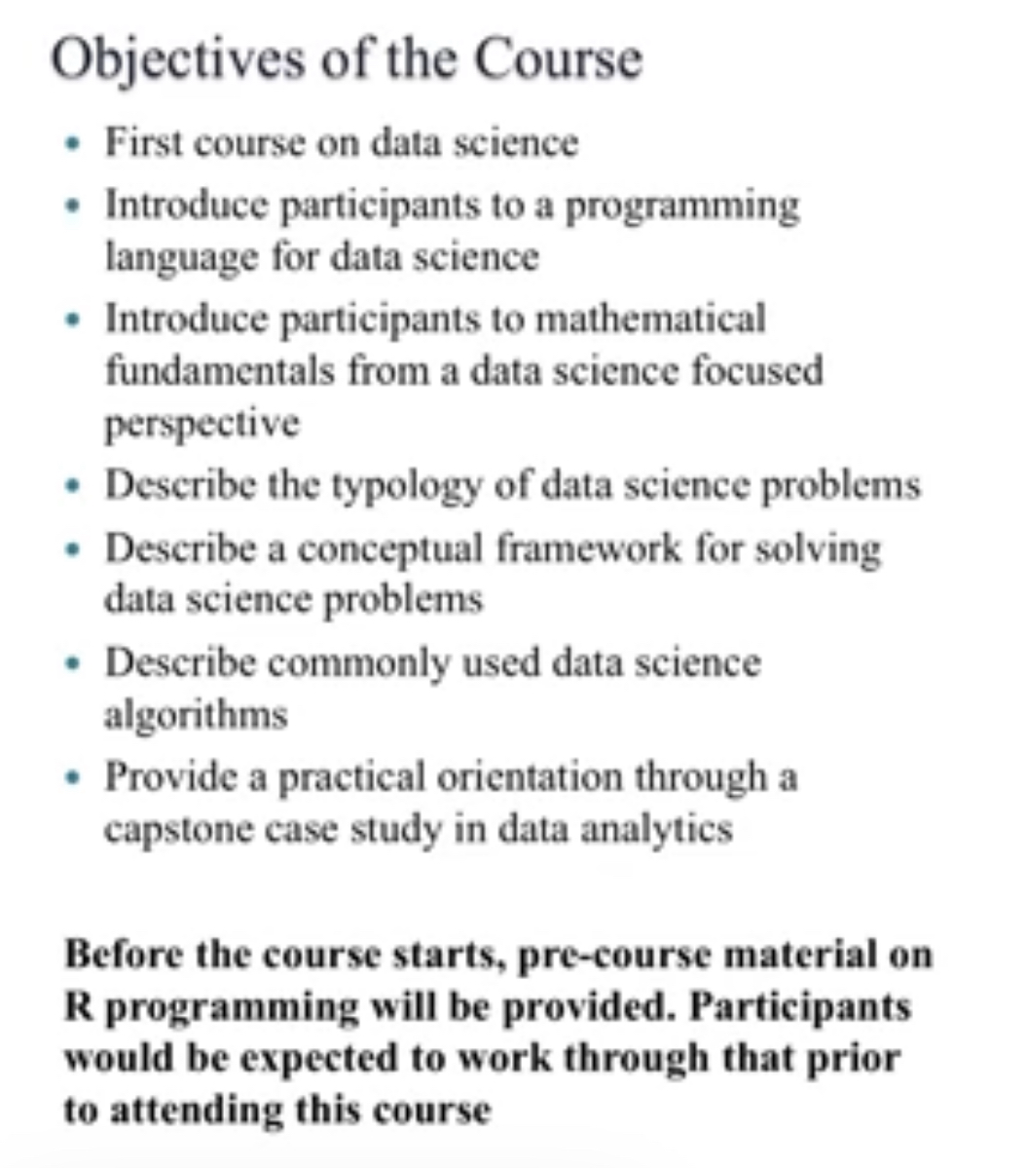
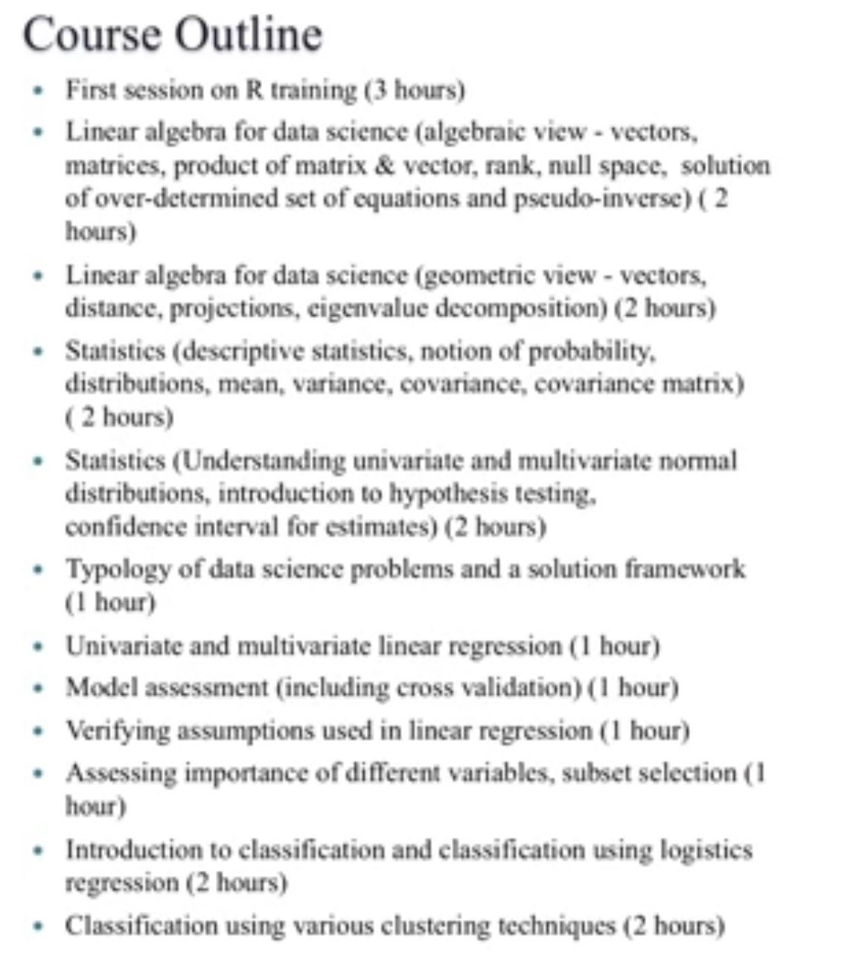
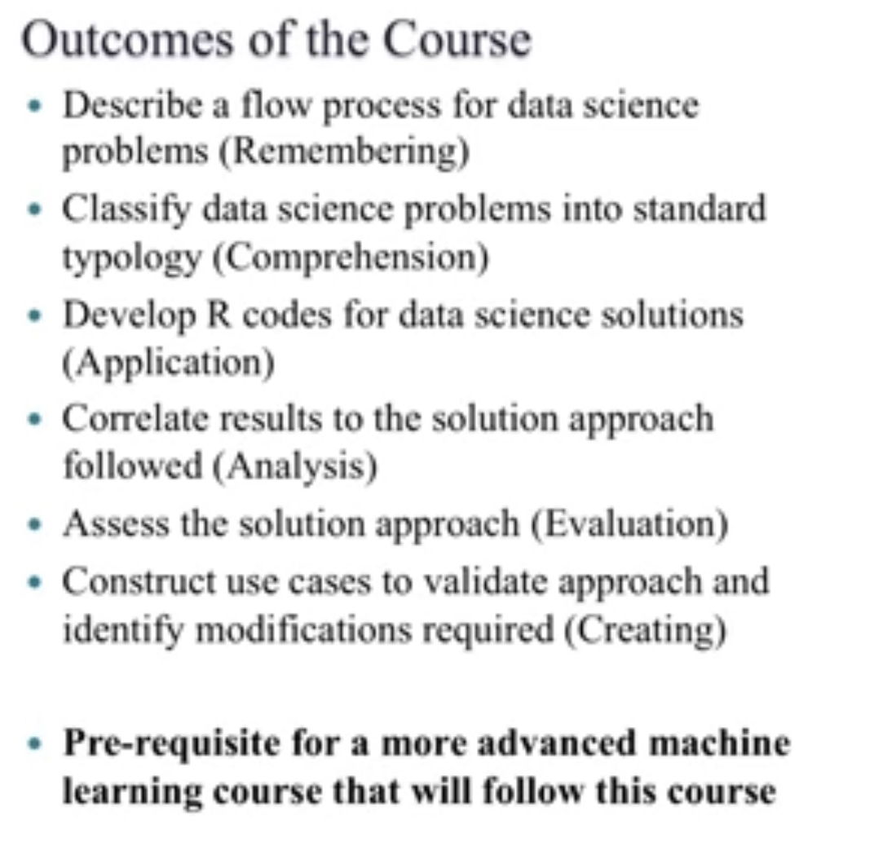

Slide 4
Let’s try some hands-on session on R Studio
Later we can check on some example questions and questions from the forum.

Slide 6
Which of the following variable names are INVALID in R?
1_variable
variable_1
_variable
variable@

Slide 7
Which of the following variable names are INVALID in R?
1_variable
variable_1
_variable
variable@

Slide 8
The function ls() in R will
set a new working directory path
list all objects in our working environment
display the path to our working directory
None of the above

Slide 9
The function ls() in R will
set a new working directory path
list all objects in our working environment
display the path to our working directory
None of the above

Slide 10
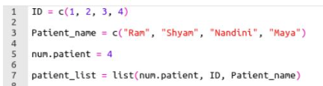
Which of the following command is used to access the value “Shyam”?
print(patient_list[3][2])
print(patient_list[[3]][1])
print(patient_list[[3]][2])
print(patient_list[[2]][2])

Slide 11
Which of the following command is used to access the value “Shyam”?
print(patient_list[3][2])
print(patient_list[[3]][1])
print(patient_list[[3]][2])
print(patient_list[[2]][2])

Slide 12
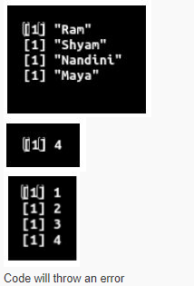
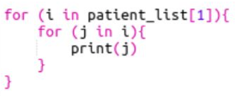
The output of the code given below is

Slide 13
The output of the code given below is

Slide 14

What is the output of following code?
double
integer
list
None of the above

Slide 15
What is the output of following code?
double
integer
list
None of the above

Slide 16
State whether the given statement is True or False. The library reshape2 is based around two key functions named melt and cast.
True
False

Slide 17
State whether the given statement is True or False. The library reshape2 is based around two key functions named melt and cast.
True
False

Slide 18

What is the output of following code?
6
4
2
8

Slide 19
What is the output of following code?
6
4
2
8

Slide 20
Create the data frame using the code given below and answer questions 8 and 9.
student_data = data.frame(student_id=c(1:4), student_name=c(‘Ram’,‘Harish’,‘Pradeep’,‘Rajesh’))

Slide 21
Choose the correct command to add a column named student_dept to the dataframe student_data.
student_data = data.frame(student_id=c(1:4), student_name=c(‘Ram’,‘Harish’,‘Pradeep’,‘Rajesh’))
student_datastudent_dept=c(“Commerce”, “Biology”, “English”, “Tamil”)
student_data[“student_dept”]= c(“Commerce”,“Biology”, “English”,“Tamil”)
student_dept= student_data[c(“Commerce”,“Biology”,“English”,“Tamil”)]
None of the above

Slide 22
Choose the correct command to add a column named student_dept to the dataframe student_data.
student_data = data.frame(student_id=c(1:4), student_name=c(‘Ram’,‘Harish’,‘Pradeep’,‘Rajesh’))
student_datastudent_dept=c(“Commerce”, “Biology”, “English”, “Tamil”)
student_data[“student_dept”]= c(“Commerce”,“Biology”, “English”,“Tamil”)
student_dept= student_data[c(“Commerce”,“Biology”,“English”,“Tamil”)]
None of the above

Slide 23
Choose the correct command to access the element Tamil in the dataframe student_data.
student_data[[4]]
student_data[[4]][3]
student_data[[3]][4]
None of the above
student_data[[4]]
student_data[[4]][3]
student_data[[3]][4]
None of the above
student_data = data.frame(student_id=c(1:4), student_name=c(‘Ram’,‘Harish’,‘Pradeep’,‘Rajesh’))
student_data[[4]]
student_data[[4]][3]
student_data[[3]][4]
None of the above

Slide 24
Choose the correct command to access the element Tamil in the dataframe student_data.
student_data[[4]]
student_data[[4]][3]
student_data[[3]][4]
None of the above
student_data[[4]]
student_data[[4]][3]
student_data[[3]][4]
None of the above
student_data = data.frame(student_id=c(1:4), student_name=c(‘Ram’,‘Harish’,‘Pradeep’,‘Rajesh’))
student_data[[4]]
student_data[[4]][3]
student_data[[3]][4]
None of the above

Slide 25
The command to check if a value is of numeric data type is ____.
typeof()
is.numeric()
as.numeric()
None of the above

Slide 26
The command to check if a value is of numeric data type is ____.
typeof()
is.numeric()
as.numeric()
None of the above

